Slide 1


ID | NAME | BATCH
QH1115 | Kidus Abebe Haileselassie | DRB2001
YJ1909 | Kidus Mesfin Mekuria | DRB2102
KX4898 | Kidus Yonas Aklog | DRB2102
HM8555 | Kirubel Esayas Mulugeta | DRB2102
XM7276 | Leul Tewodros Agonafer | DRB2102

Slide 2
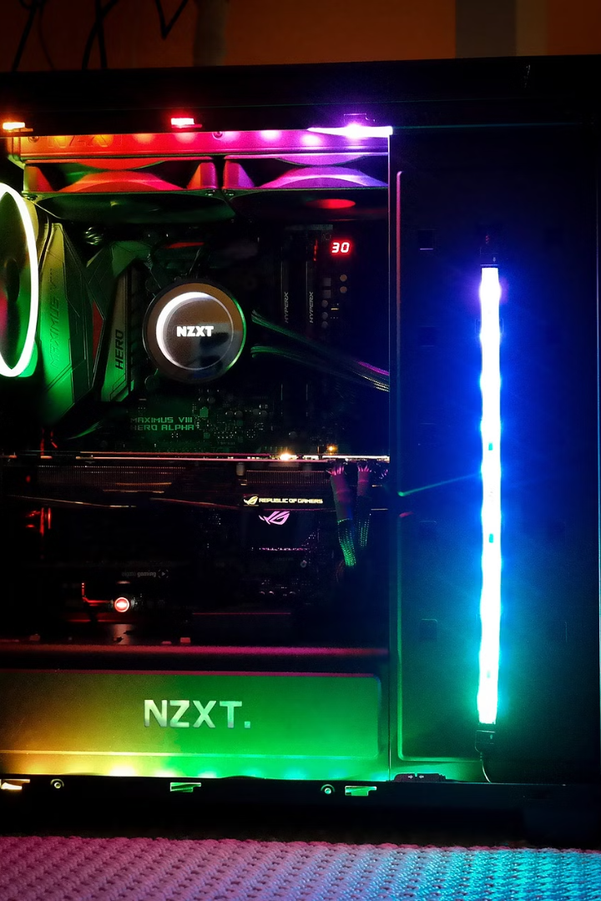
Advanced Computer Problem Diagnosis Expert System
This presentation explores an expert system designed to diagnose computer problems based on user-provided symptoms. It leverages the power of knowledge representation and reasoning to provide effective troubleshooting solutions.

Slide 3

Introduction
The expert system aims to automate computer problem diagnosis by collecting symptoms, identifying causes, and suggesting solutions based on confidence levels.
User-Friendly Interface
The system utilizes a simple and intuitive interface, allowing users to easily input their symptoms and receive tailored solutions.
Knowledge-Based Approach
The system's knowledge base stores a comprehensive set of symptoms, causes, and solutions, enabling it to provide accurate diagnoses.
Dynamic Learning
The system can learn from user interactions, expanding its knowledge and improving its diagnostic capabilities over time.

Slide 4
User Interface Overview
The user interface provides a user-friendly way to interact with the expert system. The system utilizes Prolog, a logic programming language, for its implementation.
start\_diagnosis/0
ask\_symptom/2
learn\_symptom/0, learn\_cause/0, learn\_solution/0
This predicate initiates the diagnosis process, guiding the user through a series of questions.
This predicate presents a symptom to the user and prompts for their response, collecting information about the issue.
These predicates enable users to expand the knowledge base by teaching the system new symptoms, causes, and solutions.

Slide 5
Knowledge Base Components
The knowledge base is the core of the expert system, holding the static data used for diagnosis. It is organized into key components, each representing a different aspect of computer problem diagnosis.
Component
Description
Example
Symptoms
Defined by symptom/1, representing user-observable issues.
symptom(slow\_performance)
Causes
Defined by cause/1, representing potential underlying causes of symptoms.
cause(overheating)
Relationships
Defined by symptom\_cause/2, linking symptoms to potential causes.
symptom\_cause(slow\_performance, overheating)
Confidence
Defined by confidence/2, representing the confidence level associated with a cause given a symptom.
confidence(slow\_performance, 0.8)
Solutions
Defined by solution/2, mapping causes to potential solutions.
solution(overheating, 'Clean your CPU fan')

Slide 6




Inference Engine
The inference engine is the logic behind the diagnosis process, using knowledge from the knowledge base to match symptoms to potential causes and adjust confidence levels.
Matching Symptoms
Calculating Confidence
Updating Confidence
The inference engine uses rules to match user-provided symptoms to potential causes stored in the knowledge base.
The system calculates the confidence level of each potential cause based on its relationship to the symptoms and the existing confidence values.
The confidence levels are further adjusted based on user feedback, refining the diagnosis process and improving accuracy.

Slide 7

Knowledge Acquisition and Learning Module
The expert system utilizes a knowledge acquisition and learning module to dynamically acquire new knowledge through user interactions.
1
Learning New Symptoms
2
Learning New Causes
Users can teach the system new symptoms by inputting them through the user interface, expanding its knowledge base.
The system can also learn new causes for existing symptoms, enhancing its ability to diagnose a wider range of computer problems.
3
Learning New Solutions
4
Linking Symptoms and Causes
Users can teach the system new solutions for known causes, providing a comprehensive set of troubleshooting options.
The system allows users to link new symptoms to existing causes, building relationships between observed issues and their underlying reasons.

Slide 8




Explanation Module
The expert system includes an explanation module to provide a clear understanding of the diagnostic process and the rationale behind recommended solutions.
Validation
The explanation module validates the proposed solutions, ensuring they are appropriate for the identified cause.
Confirmation
The system prompts the user for confirmation after applying the solution, verifying its effectiveness in resolving the problem.
Presentation
The system presents a detailed explanation of the diagnosis and its reasoning, providing insight into the decision-making process.

Slide 9

View Knowledge Base
The system allows users to view the knowledge base, providing transparency into its stored information and enabling them to understand its reasoning capabilities.
1
Listing Symptoms
Users can view all the known symptoms, gaining insight into the range of issues the system can diagnose.
2
Listing Causes
The system allows users to view all the known causes for computer problems, revealing its underlying knowledge of potential issues.
3
Listing Solutions
Users can access the knowledge base to view the available solutions for different causes, gaining a comprehensive understanding of troubleshooting options.

Slide 10


Conclusion and Future Enhancements
The expert system successfully diagnoses computer problems using expert knowledge, providing suggested solutions and enhancing the troubleshooting process.
Graphical User Interface (GUI)
Advanced Reasoning Capabilities
Implementing a graphical user interface would enhance user interaction, providing a more intuitive and engaging experience.
Further development could incorporate more complex reasoning capabilities, enhancing the system's ability to handle complex computer issues.

